Slide 1
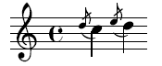
Grace: Safe Multithreaded Programming for C/C++ [OOPSLA 2009]
Emery Berger, Ting Yang, Tongping Liu, Gene Novark
University of Massachusetts, Amherst
www.cs.umass.edu/~emery

Slide 2
Garbage Collection

Slide 3

Garbage Collection

Slide 4
Garbage Collection
Idea: robot takes care of your garbage

Slide 5
Garbage Collection
Idea: runtime takes care of your memory errors

Slide 6

Garbage Collection

Slide 7
Garbage Collection
Result: success story!

Slide 8
Garbage Collection
Result: success story! (after ~35 years)

Slide 9

“Garbage Collection for Concurrency”

Slide 10
“Garbage Collection for Concurrency”
Goal: You write concurrent programs

Slide 11
“Garbage Collection for Concurrency”
Goal: You write concurrent programs
with as many bugs as you want!

Slide 12
“Garbage Collection for Concurrency”
Goal: You write concurrent programs
with as many bugs as you want!
Wall-E cleans up after you

Slide 13
“Garbage Collection for Concurrency”
How do I “garbage collect” concurrency errors?

Slide 15
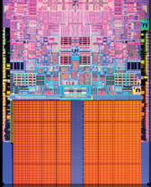

Slide 27
color = ; row = 0; // globals
void nextStripe(){
for (c = 0; c < Width; c++) {
drawBox (c,row,color);
}
color = (color == )?  : ; row++;
}
for (n = 0; n < 9; n++) {
nextStripe();
}

Slide 29


Slide 30


Slide 36
color = ; row = 0; // globals
void nextStripe(){
for (c = 0; c < Width; c++) {
drawBox (c,row,color);
}
color = (color == )?  : ; row++;
}
for (n = 0; n < 9; n++) {
spawn nextStripe();
}
sync;

Slide 37

“
”

Slide 43
race condition

Slide 44
color = ; row = 0; // globals
void nextStripe(){
for (c = 0; c < Width; c++) {
drawBox (c,row,color);
}
color = (color == )?  : ; row++;
}
for (n = 0; n < 9; n++) {
spawn nextStripe();
}
sync;

Slide 45
color = ; row = 0; // globals
void nextStripe(){
for (c = 0; c < Width; c++) {
drawBox (c,row,color);
}
color = (color == )?  : ; row++;
}
for (n = 0; n < 9; n++) {
spawn nextStripe();
}
sync;

Slide 46
color = ; row = 0; // globals
void nextStripe(){
for (c = 0; c < Width; c++) {
lock(); drawBox (c,row,color); unlock();
}
lock();
color = (color == )?  : ; row++;
unlock();
}
for (n = 0; n < 9; n++) {
spawn nextStripe();
}
sync;

Slide 51
atomicity violation

Slide 52
color = ; row = 0; // globals
void nextStripe(){
for (c = 0; c < Width; c++) {
lock(); drawBox (c,row,color); unlock();
}
lock();
color = (color == )?  : ; row++;
unlock();
}
for (n = 0; n < 9; n++) {
spawn nextStripe();
}
sync;

Slide 53
color = ; row = 0; // globals
void nextStripe(){
lock();
for (c = 0; c < Width; c++) {
drawBox (c,row,color);
}
color = (color == )?  : ; row++;
unlock();
}
for (n = 0; n < 9; n++) {
spawn nextStripe();
}
sync;

Slide 56
deadlock

Slide 60
order violation

Slide 62
sequential

Slide 63

sequential

Slide 65
race conditions

Slide 66
race conditions
atomicity violations

Slide 67
race conditions
atomicity violations
deadlock

Slide 68
race conditions
atomicity violations
deadlock
order violations

Slide 69


Slide 70
race conditions
atomicity violations
Grace
deadlock
order violations

Slide 71
race conditions
atomicity violations
Grace
deadlock
order violations

Slide 72
race conditions
atomicity violations
Grace
deadlock
order violations
sequential

Slide 73
Grace
% g++ myprog.cpp –lpthread –o myprog

Slide 74
Grace
% g++ myprog.cpp –lgrace –o myprog

Slide 75
Grace
% g++ myprog.cpp –lgrace –o myprog
sequential

Slide 76
Grace
% g++ myprog.cpp –lgrace –o myprog
sequential
race conditions
atomicity violations
deadlock
order violations

Slide 77
Grace
% g++ myprog.cpp –lgrace –o myprog
sequential
race conditions
atomicity violations
deadlock
order violations

Slide 78
Grace
1.
sequential
+
?

Slide 79
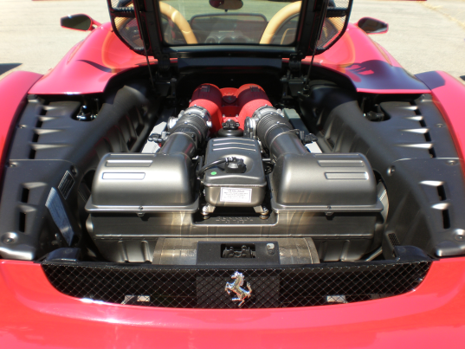
Grace
1.
sequential
+
?
2.

Slide 80
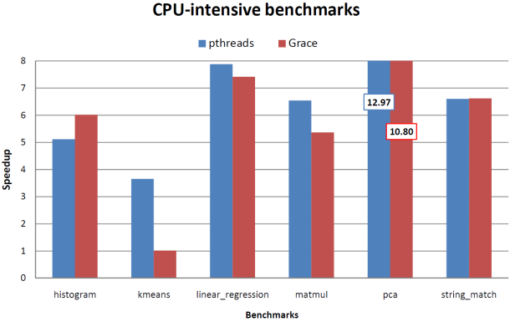
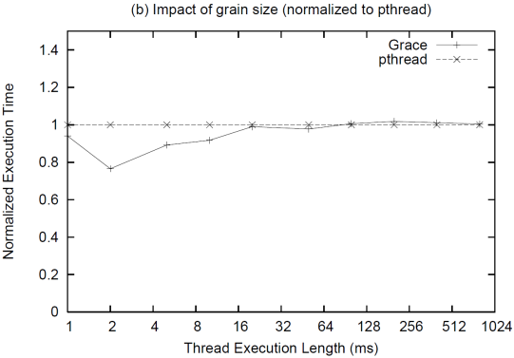
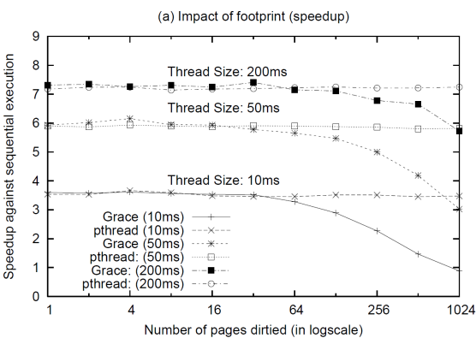
Grace
1.
sequential
+
?
2.
3.

Slide 81
1.
sequential
+
?

Slide 82
1.
sequential
+
?
t1 = spawn f(x);
t2 = spawn g(y);
sync;

Slide 83
1.
sequential
+
?
spawn f(x)
t1 = spawn f(x);
t2 = spawn g(y);
sync;

Slide 84

1.
sequential
+
?
spawn f(x)
t1 = spawn f(x);
t2 = spawn g(y);
sync;
f(x)

Slide 85
1.
sequential
+
?
spawn f(x)
t1 = spawn f(x);
t2 = spawn g(y);
sync;
f(x)
spawn g(y)

Slide 86
1.
sequential
+
?
spawn f(x)
t1 = spawn f(x);
t2 = spawn g(y);
sync;
f(x)
spawn g(y)
g(y)

Slide 87
1.
sequential
+
?
spawn f(x)
t1 = spawn f(x);
t2 = spawn g(y);
sync;
f(x)
spawn g(y)
g(y)
sync

Slide 88
1.
sequential
+
?
spawn f(x)
t1 = spawn f(x);
t2 = spawn g(y);
sync;
f(x)
spawn g(y)
g(y)
sync

Slide 89
1.
sequential
+
?
spawn f(x)
t1 = spawn f(x);
t2 = spawn g(y);
sync;
f(x)
spawn g(y)
g(y)
left-to-right, depth-first ordering
sync

Slide 90
1.
sequential
+
?
f(x)
t1 = spawn f(x);
t2 = spawn g(y);
sync;
g(y)

Slide 91
1.
sequential
+
?
“
f(x)
”
t1 = spawn f(x);
t2 = spawn g(y);
sync;
g(y)

Slide 92
1.
sequential
+
?
“
f(x)
”
g(y)

Slide 93
1.
sequential
+
?
“
f(x)
”
race conditions
g(y)
atomicity violations
deadlock
order violations

Slide 94
1.
sequential
+
?
“
f(x)
”
race conditions
g(y)
atomicity violations
deadlock
order violations

Slide 95
1.
sequential
+
?
“
f(x)
”
race conditions
g(y)
atomicity violations
deadlock
order violations

Slide 96

1.
sequential
+
?
“
f(x)
”
race conditions
g(y)
atomicity violations
deadlock
order violations

Slide 97
1.
sequential
+
?
“
f(x)
”
race conditions
g(y)
atomicity violations
deadlock
order violations

Slide 98
1.
sequential
+
?
“
f(x)
”
race conditions
g(y)
atomicity violations
deadlock
order violations

Slide 99
1.
sequential
+
?
“
f(x)
”
race conditions
g(y)
atomicity violations
deadlock
order violations

Slide 100

1.
sequential
+
?
“
f(x)
”
g(y)

Slide 101
1.
sequential
+
?
“
f(x)
”
g(y)

Slide 102

1.
sequential
+
?
“
f(x)
”
g(y)

Slide 103
1.
sequential
+
?
“
f(x)
”
g(y)

Slide 104
1.
sequential
+
?
“
f(x)
”
g(y)

Slide 105

1.
sequential
+
?
“
f(x)
”
g(y)
Fork-join (e.g., map-reduce, Cilk, TBB…)

Slide 106
2.
?
What’s under the hood?

Slide 107

2.
?
“Magic!”

Slide 108

2.
?
+

Slide 109
2.
?

Slide 110

2.
?
t1 = spawn f(x);
t2 = spawn g(y);
sync;

Slide 111

2.
?
t1 = spawn f(x);
t2 = spawn g(y);
sync;
if (!fork())
f(x);
if (!fork())
g(y);
// check;

Slide 112
spawn f(x)
2.
?
f(x)
spawn g(y)
g(y)
sync
if (!fork())
f(x);
if (!fork())
g(y);
// check;

Slide 113
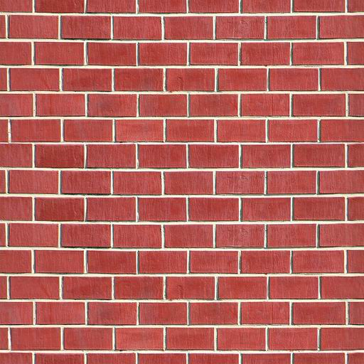
spawn f(x)
2.
?
f(x)
spawn g(y)
g(y)
sync
if (!fork())
f(x);
if (!fork())
g(y);
// check;

Slide 114
spawn f(x)
2.
?
f(x)
spawn g(y)
g(y)
sync
Note: Nested threads ok
if (!fork())
f(x);
if (!fork())
g(y);
// check;

Slide 115
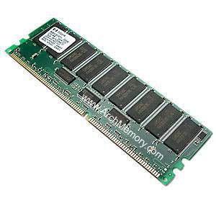
spawn f(x)
2.
?
f(x)
spawn g(y)
g(y)
mmap
sync

Slide 116
spawn f(x)
2.
?
f(x)
spawn g(y)
g(y)
mmap
sync

Slide 117
spawn f(x)
2.
?
f(x)
spawn g(y)
g(y)
mmap
sync

Slide 118
spawn f(x)
2.
?
f(x)
spawn g(y)
g(y)
sync

Slide 119
spawn f(x)
2.
?
f(x)
spawn g(y)
g(y)
sync
1

Slide 120
spawn f(x)
2.
?
f(x)
spawn g(y)
g(y)
sync
1
2

Slide 121


2.
?
scalable heap + aligned globals I/O (buffering + ordering)

Slide 122
3.

Slide 124
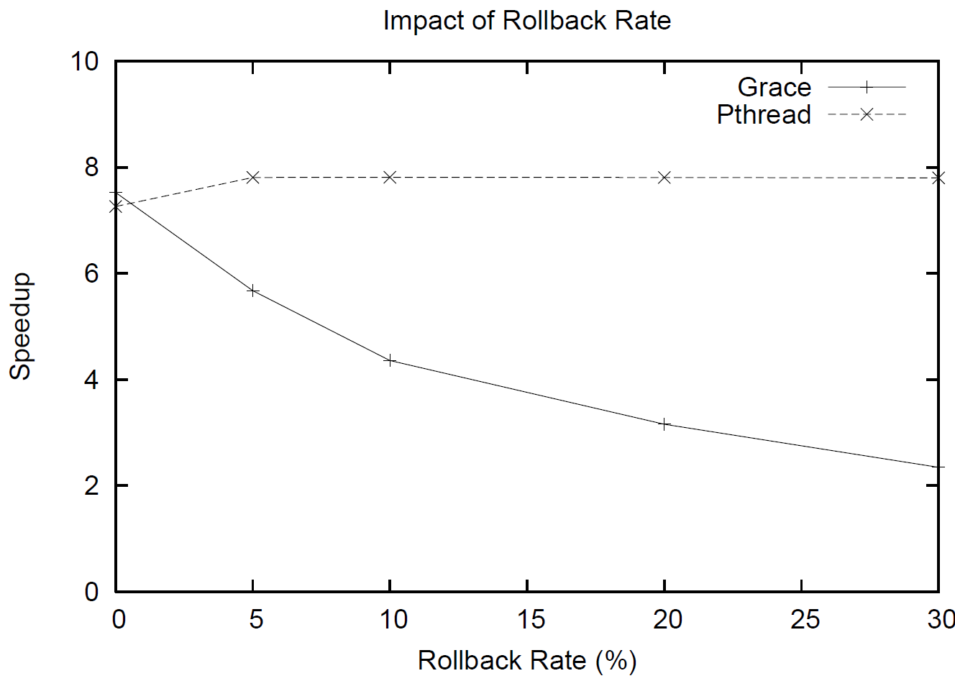

Slide 125



Slide 126
Safe and (usually) fast*
*1—16 lines changed

Slide 127
Safe and (usually) fast…
benign race

Slide 128

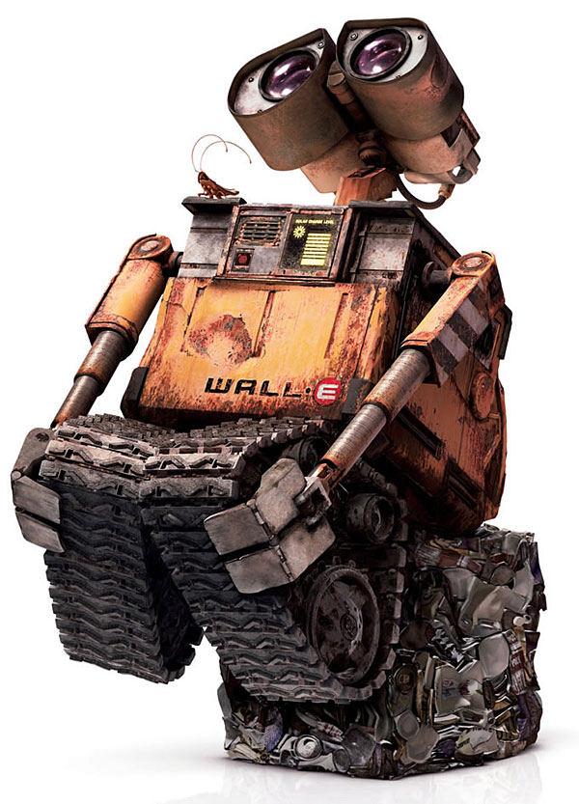
Grace
sequential
race conditions
atomicity violations
deadlock
order violations
% g++ myprog.cpp –lgrace –o myprog

Slide 129


“Moltes gràcies”

